Slide 1
Harnessing trends in the health and fitness industry for future growth and expansion of the Bellabeat app
Bellabeat
November 2023

Slide 2
Problem:
Bellabeat is continuing to grow and a new marketing strategy is necessary to maintain a healthy trajectory.
Ask:
What are existing trends in the health and fitness app market that can compare to Bellabeat?
How can these trends help influence Bellabeat marketing strategy?

Slide 3
When looking at current industry trends
Users are actively tracking a wide-range of statistical health and fitness categories.
Is the Bellabeat app capable of monitoring and recording greater information that is wanted by the consumer base?

Slide 4
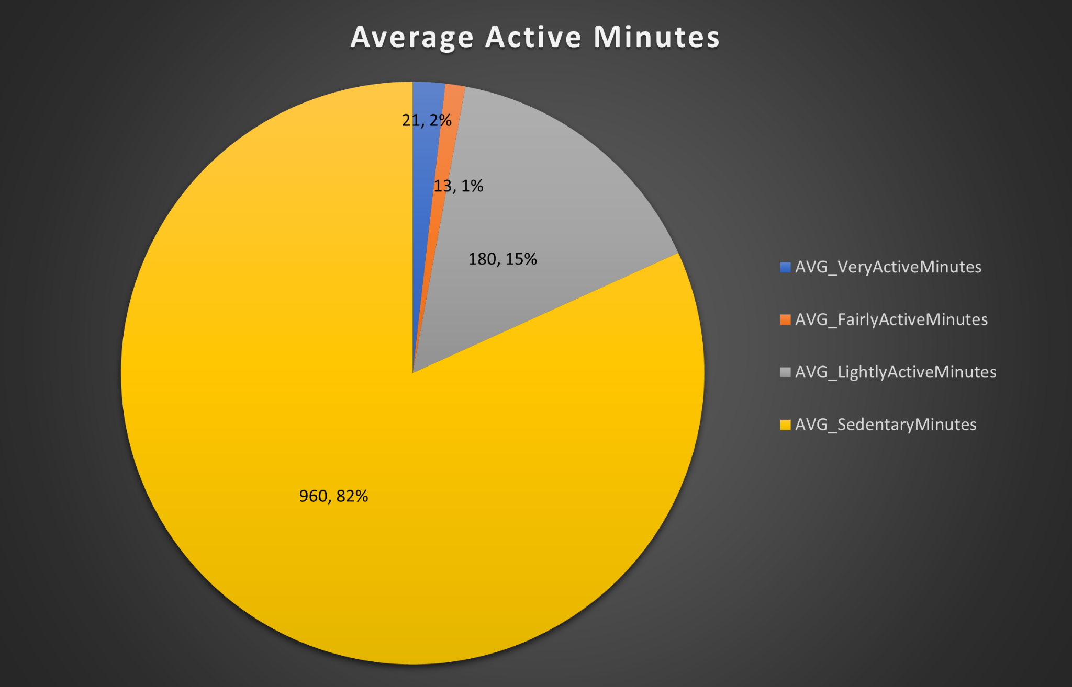
Looking at information found from FitBit users, we can identify trends that are likely to exist within and support Bellabeat and the app.
These users here are tracking the length of time they are recorded as being active from Very Active to Sedentary.
Source: https://www.kaggle.com/arashnic/fitbit

Slide 5
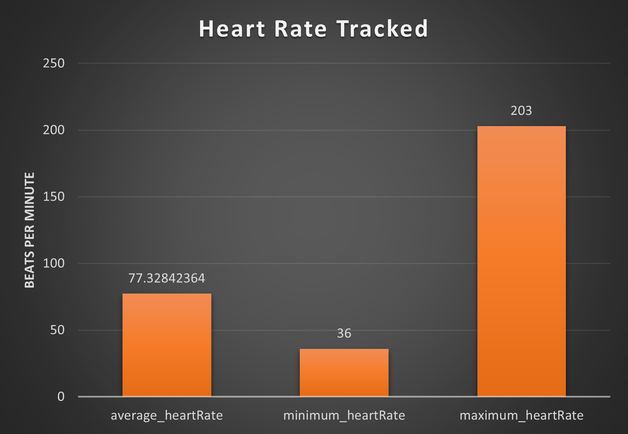
These trends are extending from everyday, around-the-house use, to highly intensive sessions of activity.
Source: https://www.kaggle.com/arashnic/fitbit

Slide 6
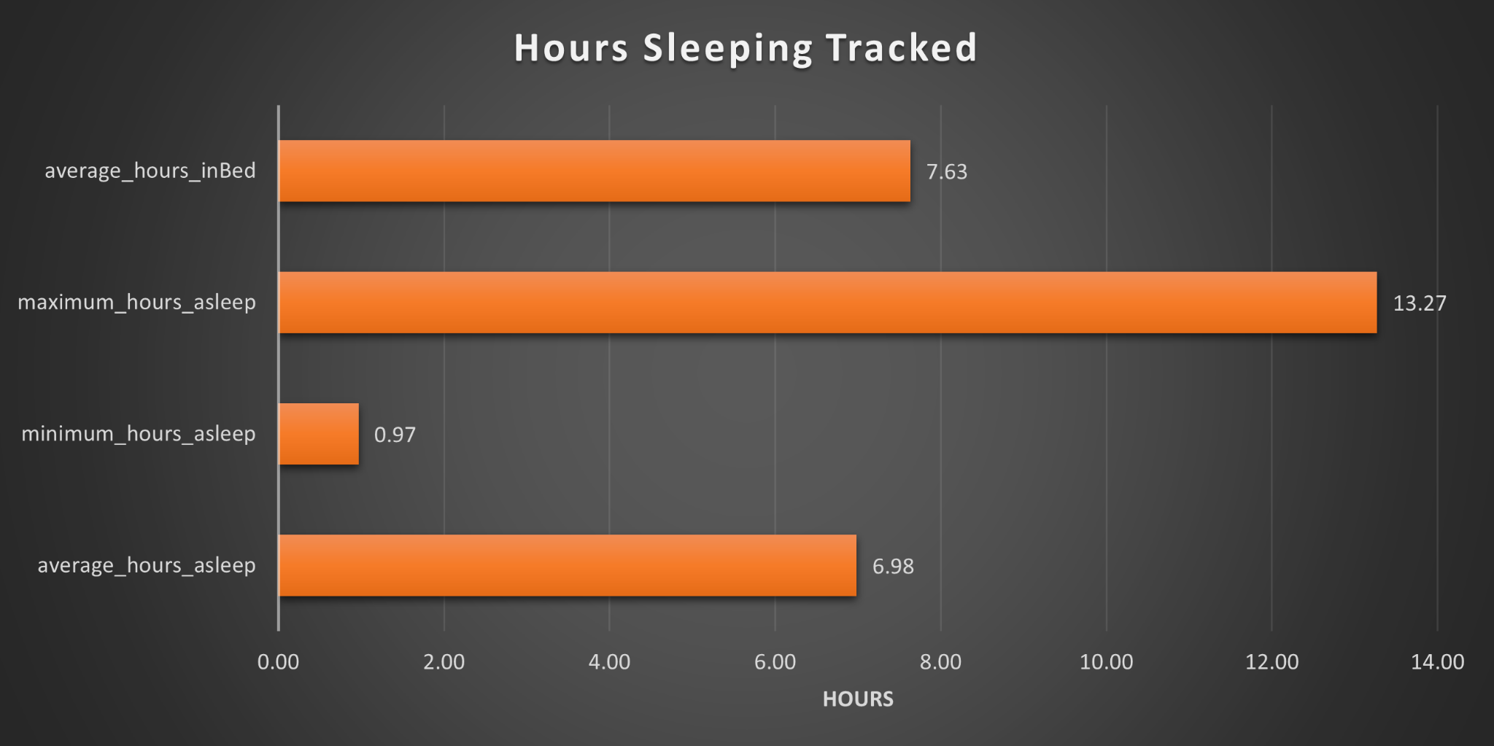
Source: https://www.kaggle.com/arashnic/fitbit
These users are also tracking moments of rest, outside of physical activity.

Slide 7
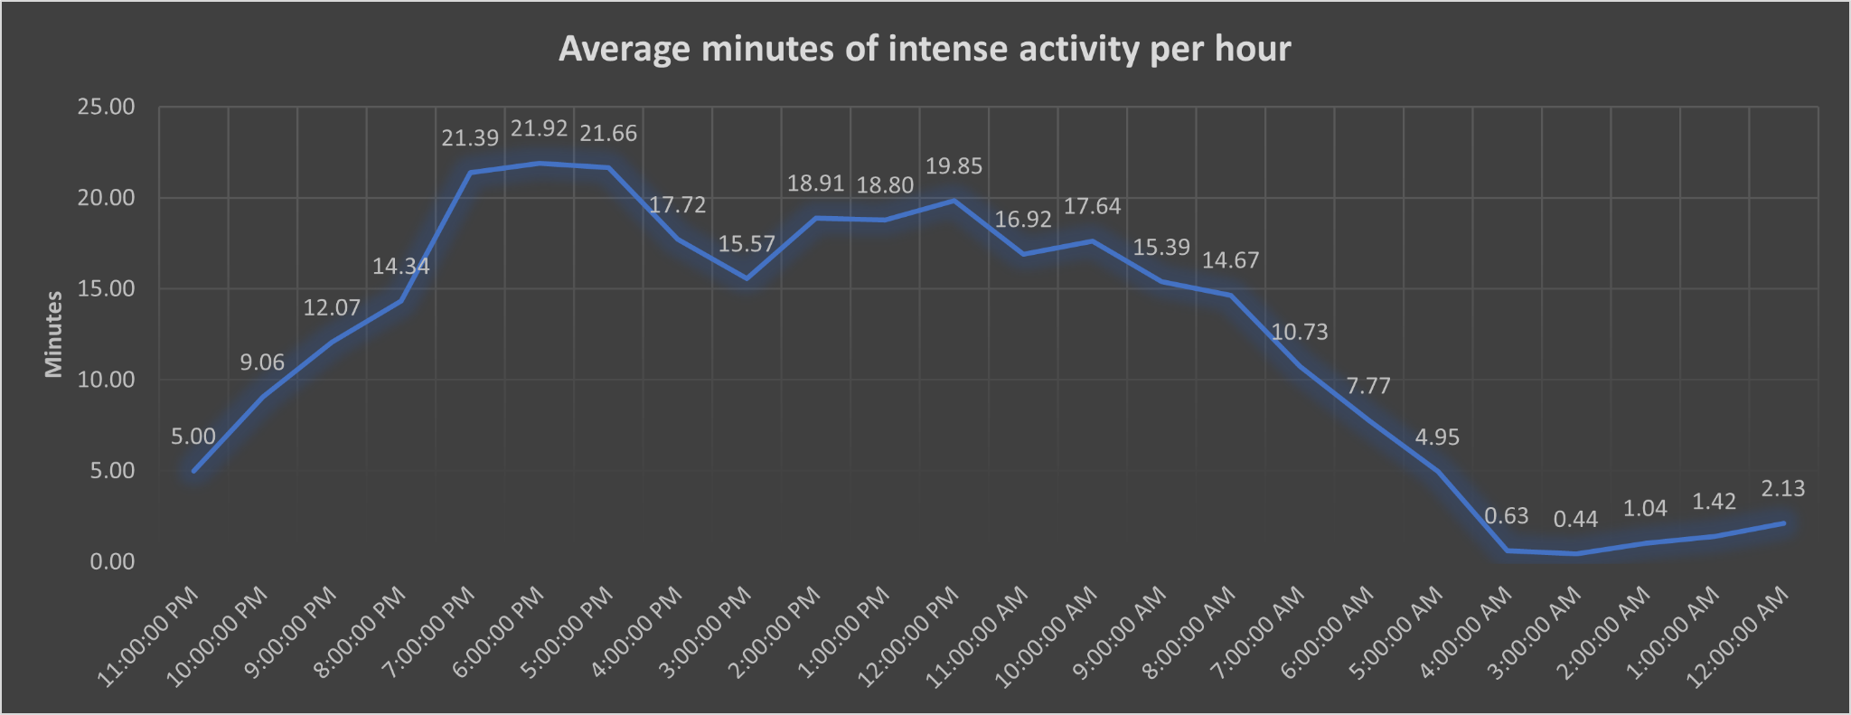
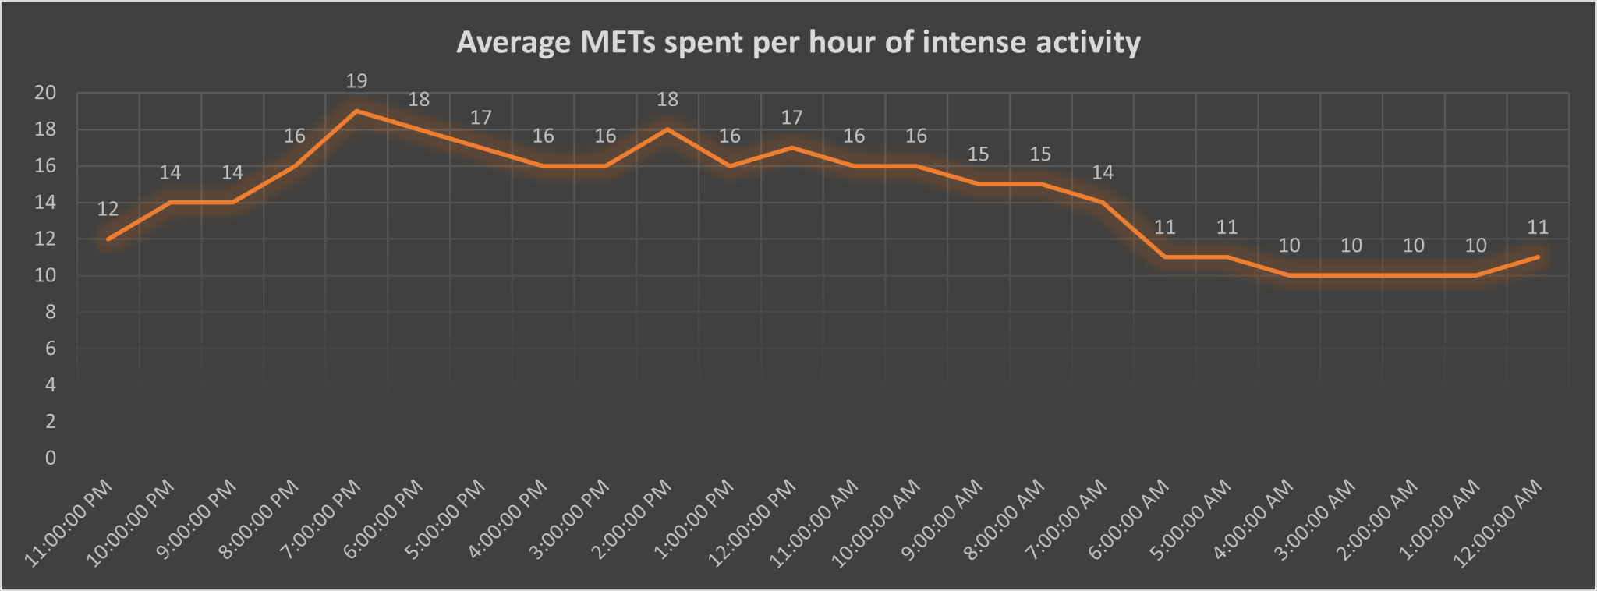
Recent trends show people looking more closely into, not only the kind of activity they are performing, but the level of intensity they are achieving during these activities.
Source: https://www.kaggle.com/arashnic/fitbit

Slide 8
A noticeable lack of information about nutrition stuck out amongst all of the data.
Including the tracked statistics of Bellabeat.

Slide 9
In summary:
Analytical Goals:
Everyday, more people are increasingly aware of and seek a deeper understanding of their health and fitness activities.
In a new age of technology, it is now easier than ever before to share this knowledge with our consumer base. As I believe it is part of our responsibility to do so.
Based on these trends, the Bellabeat app should implement methods to track more advanced health and fitness statistics. Examples of these statistics being nutrition and metabolic activity.

Slide 10
Timeline of Events
11
12
01
02
W1
W2
W3
W4
W1
W2
W3
W4
W1
W2
W3
W4
W1
W2
W3
W4
Analysis
Present Analysis
Development of new app functions
Beta testing
Live Launch
LOREM

Slide 11
If nutrition and metabolic analytics improve growth in the Bellabeat app, further analysis and exploration to improve the new features will be necessary for greater development.

Slide 12
Thank you

